Slide 1

PRESS RELEASE
GHANA, JUNE 2025
PRODUCER PRICE INDEX AND INFLATION
Presented by
Dr. Alhassan Iddrisu
Government Statistician
16th July 2025

Slide 2
In this release, we present:
Introduction
Main Points
Price Drivers
Conclusion
Recommendation
Publications

Slide 3
Introduction
The Producer Price Index (PPI) measures the average change in the selling prices of goods and services as received by domestic producers over time.
PPI computation is based on a fixed basket of products using data on prices of 2,639 items in the basket received by 603 domestic producers each month, with March 2020 to February 2021 = 100 as the base year.
The Prices collected are known as factory gate prices, which are the prices firms receive for selling products or offering services.

Slide 4
Introduction
These prices exclude sales and excise taxes, government subsidies, and other costs incurred by other intermediaries and consumers.
Producer price inflation is the rate at which the price received by domestic producers for their goods and services rises or falls. It is measured as the percentage change in the PPI between two periods.
The producer price inflation is presented on both a month-on-month basis and a year-on-year basis.

Slide 5
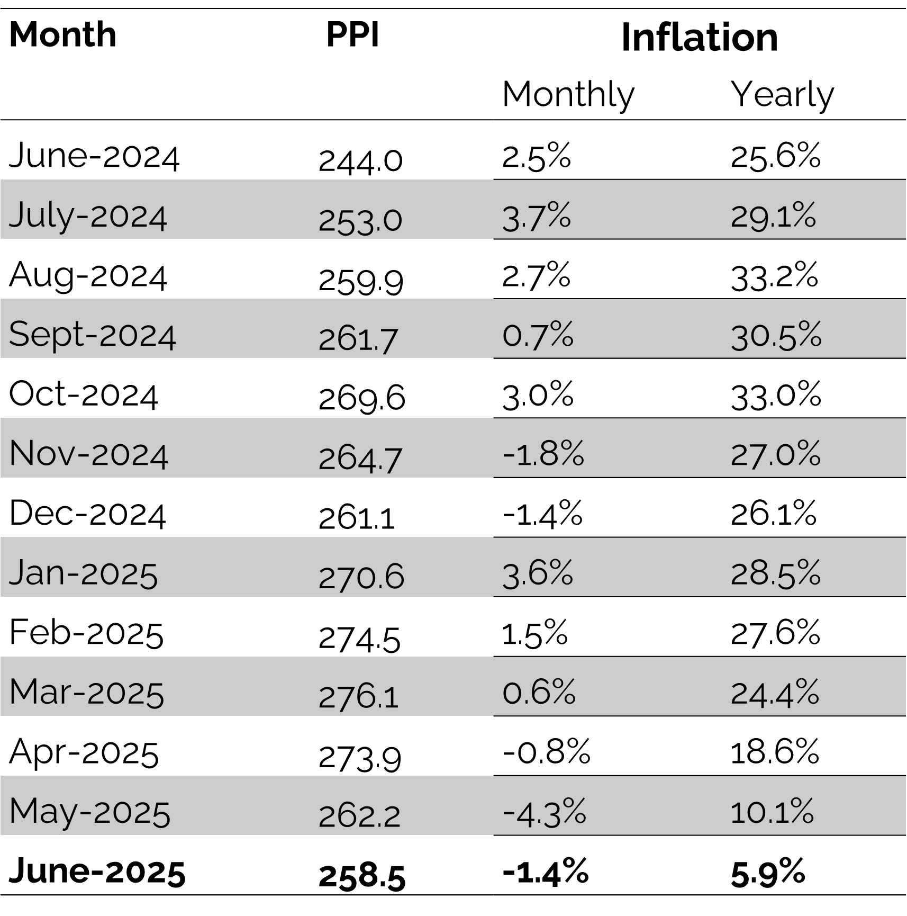
Main Points: PPI and Inflation for June 2025(1/2)
The Producer Price Index (PPI) for June 2025 was 258.5, down from 262.2 in May 2025 and up 244.0 in June 2024.
Therefore, Year-on-Year (Y-o-Y) producer price inflation for all goods and services was 5.9% in June 2025,.
This means that on average, the ex-factory price of goods and services increased by 5.9% between June 2024 and June 2025. The Y-on-Y produce price inflation is:
  4.2 ppt lower than inflation recorded in May 2025;
  19.7 ppts lower than inflation recorded a year earlier (Jun 2024);
  the fifth consecutive month we have seen a decline; and
  The lowest inflation since Nov 2023
On a month-on-month (M-on-M) basis, there was producer price deflation of 1.4% between May and June 2025 meaning that the average prices that producers received for their goods and services in June was lower than that in May by 1.4%.

Slide 6
Main Points: Year-on-Year Inflation for June 2025
No | Sectors | Weights | May-25 |  | Jun-25 |  | Change in Inflation between May & June
 |  |  | Inflation | Contribution | Inflation | Contribution
 |  |  | % | ppt | % | ppt | ppt
 | All Activity PPI | 100.0 | 10.1 | 10.1 | 5.9 | 5.9 | -4.2
1 | Mining and quarrying | 43.7 | 13.7 | 6.0 | 6.5 | 2.8 | -7.2
2 | Manufacturing | 35.0 | 9.8 | 3.4 | 7.6 | 2.7 | -2.2
3 | Electricity and gas | 4.3 | 8.9 | 0.4 | 5.1 | 0.2 | -3.8
4 | Water supply; sewerage, waste management | 2.3 | 4.2 | 0.1 | 3.6 | 0.1 | -0.6
5 | Construction | 0.9 | 7.4 | 0.1 | 6.0 | 0.1 | -1.4
6 | Transportation and storage | 2.4 | -4.8 | -0.1 | -7.0 | -0.2 | -2.2
7 | Accommodation and food service activities | 0.4 | 6.5 | 0.0 | -2.7 | 0.0 | -9.2
8 | Information and communication | 11.1 | 2.9 | 0.3 | 2.6 | 0.3 | -0.3

Slide 7
Main Points: Month-on-Month Inflation for June 2025
No | Sectors | Weights | May-25 |  | Jun-25 |  | Change in Inflation between May & June
 |  |  | Inflation | Contribution | Inflation | Contribution
 |  |  | % | ppt | % | ppt
 | All Activity PPI | 100 | -4.3 | -4.3 | -1.4 | -1.4 | 2.9
1 | Mining and quarrying | 43.7 | -4.8 | -2.1 | -2.0 | -0.9 | 2.8
2 | Manufacturing | 35.0 | -5.6 | -2.0 | -0.9 | -0.3 | 4.7
3 | Electricity and gas | 4.3 | 4.6 | 0.2 | -3.4 | -0.1 | -8.0
4 | Water supply; sewerage, waste management | 2.3 | 0.1 | 0.0 | -0.1 | 0.0 | -0.2
5 | Construction | 0.9 | -2.8 | 0.0 | -0.4 | 0.0 | 2.4
6 | Transportation and storage | 2.4 | -13.5 | -0.3 | 0.7 | 0.0 | 14.2
7 | Accommodation and food service activities | 0.4 | -9.2 | 0.0 | -6.6 | 0.0 | 2.6
8 | Information and communication | 11.1 | -0.3 | 0.0 | -0.2 | 0.0 | 0.1

Slide 8
Year-on-Year Producer Inflation by Sectors (%)

Slide 9
June 2025 Producer Inflation by Sub-Sectors (%)

Slide 10
June 2025 Producer Inflation of Sub-groups within the Construction Sub-Sector

Slide 11
June 2025 Inflation of Sub-groups within the Mining and Quarrying Sub-Sector

Slide 12
June 2025 Producer Inflation of Sub-groups in the Manufacturing sub-sector

Slide 13
Producer Inflation in the Services Sector for June 2025

Slide 14
Highlights for June 2025 Y-on-Y Producer Inflation
6.8%
Industry less construction
3.2%
Water supply, sewerage and waste management
10.1%
Year-on-year
Producer Inflation
May 2025
7.6%
Manufacturing
6.5%
Mining and quarrying
5.9%
Year-on-year Producer Inflation
June 2025
0.7%
Service
5.1%
Electricity and gas
2.6%
Information and communication
-2.7%
Accommodation and food
6.0%
Construction
-7.0%
Transport and storage

Slide 15
Highlights for June 2025 M-on-M Producer Inflation
-1.6%
Industry less construction
-3.4%
Electricity and gas
-4.3%
Month-on-month
producer inflation
May 2025
-0.1%
Water supply, sewerage and waste management
-1.4%
Month-on-month
Producer Inflation
June 2025
-0.9%
Manufacturing
-0.3%
Services
-2.0%
Mining and quarrying
0.7%
Transport and storage
-0.2%
Information and communication
-0.4%
Construction
-6.6%
Accommodation and food

Slide 16
Conclusion (1)
  In June 2025, Ghana’s Producer Price Inflation dropped to 5.9%, down from 10.1% in May representing a 4.2 percentage points fall, the 5th consecutive month we have seen a decline, and the lowest producer inflation rate recorded since November 2023.
  The data also show a producer price deflation of 1.4% between May and June 2025 meaning that the average prices that producers received for their goods and services fell by 1.4% in June compared to May 2025.
  Mining and Quarrying, Ghana’s largest sector with weight of 43.7%, saw inflation plunge by 7.2 percentage points from 13.7% in May to 6.5% in June.

Slide 17
Conclusion (2)
Similarly, Manufacturing, which makes up 35% of the PPI, eased from 9.8% to 7.6%, shedding off 2.2 ppts. These two sectors alone accounted for the biggest share of the inflation fall.
Prices are actually falling in some sectors. Transport costs dropped further from a -4.8% in May to -7.0% June while hotel and restaurant prices swung from +6.5% to -2.7%, a huge 9.2 ppt swing.
If these savings reach consumers, we could see real relief on the road, at the table, and when we travel.

Slide 18
Recommendation
For businesses, rethink pricing and renegotiate smartly. Falling costs bring opportunity, but tighter margins too. Stay ahead by innovating, not just adjusting prices.
For government, lock in stability, boost production, and support key sectors like mining and manufacturing with smart incentives to drive demand, protect jobs, and keep the momentum strong.
For households and consumers watch prices closely. If producer costs are falling, retail prices should too, all else remaining constant. Buy smart, question markups, and support brands that pass savings on.

Slide 19
Publications
PowerPoint Presentation on June 2025 Producer Price Index and Inflation
June 2025 PPI and Inflation Newsletter
Detailed PPI data on the Statsbank
Infographics for June 2025 PPI and Producer Inflation

Slide 20
THANK YOU
End of Press Release for
June 2025 Producer Price Index
For enquiries, please contact:
Anthony Krakah (PhD)
(Head, Business Statistics Unit, GSS) anthony.krakah@statsghana.gov.gh

Slide 21
Producer Price Index and Inflation
July 2025

